Slide 1
Physical mathematics 1.1 Statements
Assumptions of Physics collaboration

Slide 3
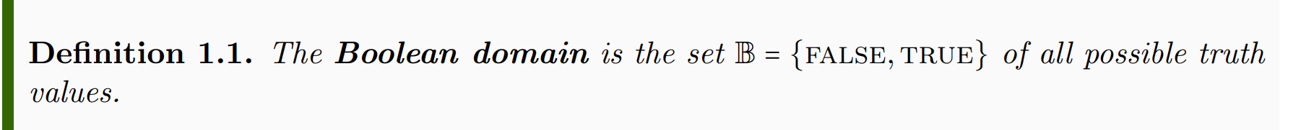
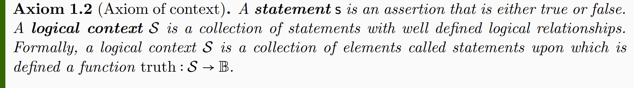
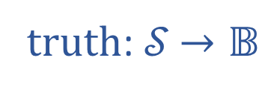

truth: 𝒮 $→𝔹$
𝒮
$$𝔹$$

Slide 4
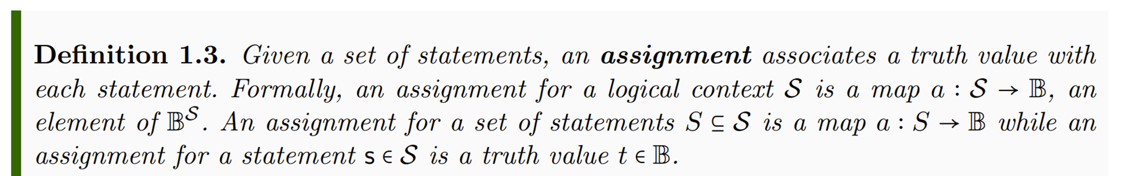

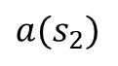
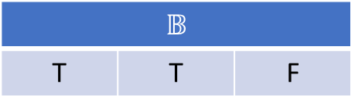
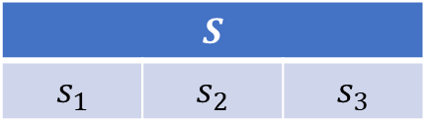
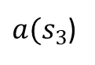
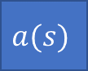
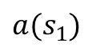
TODO: make horizontal
$$S$$
$$s_{1}$$ | $$s_{2}$$ | $$s_{3}$$
$$a(s)$$
$$𝔹$$
T | T | F
$$a(s_{1})$$
$$a(s_{2})$$
$a(s_{3}$)

Slide 5
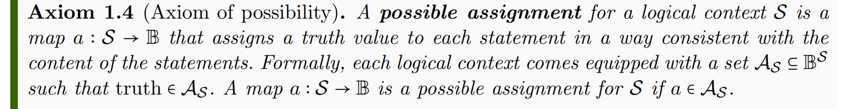
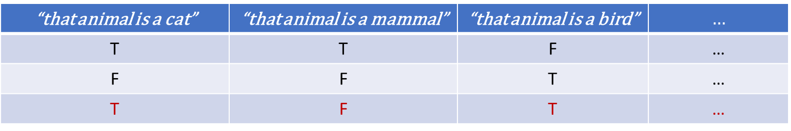
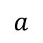
TODO: columns with text, add an “impossible assignment”
“that animal is a cat” | “that animal is a mammal” | “that animal is a bird” | $$…$$
T | T | F | …
F | F | T | …
T | F | T | …
$$a$$

Slide 6
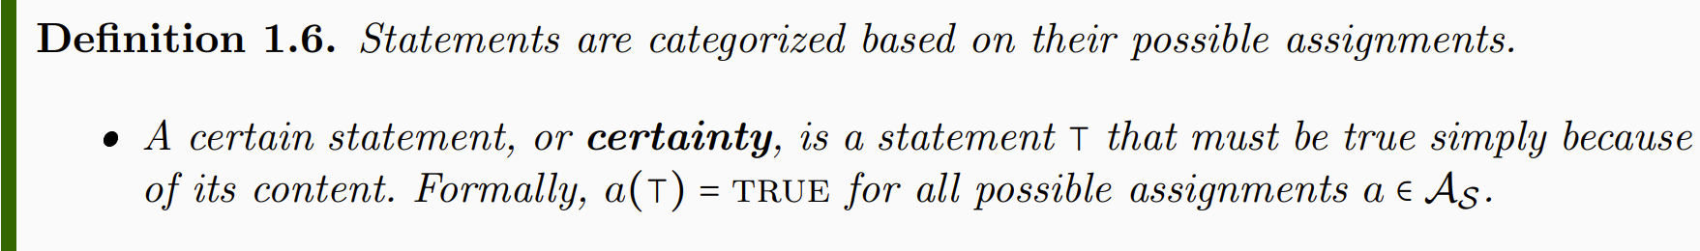
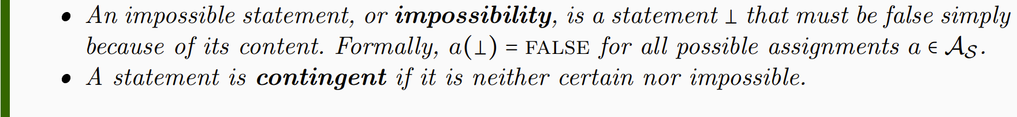
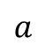
TODO: Table
“that mammal is a mammal” | “that mammal is a cat” | “that mammal is a bird”
T | T | F
T | F | F
T | F | F
T | T | F
… | … | …
$$a$$

Slide 7
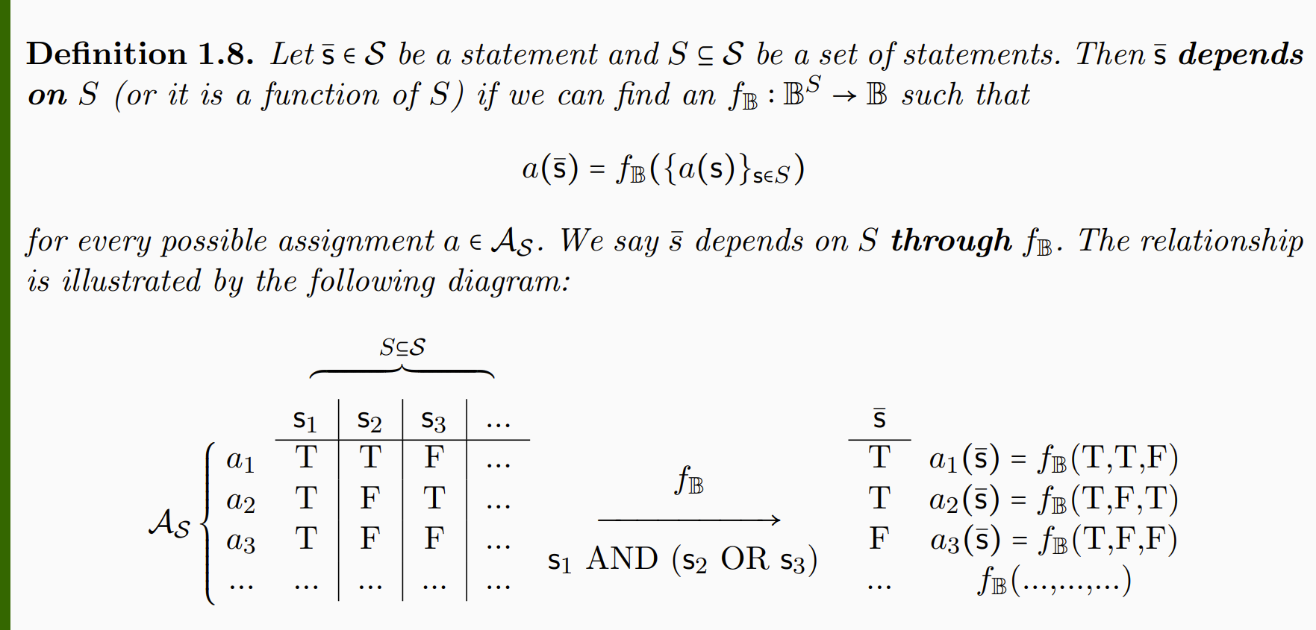

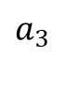
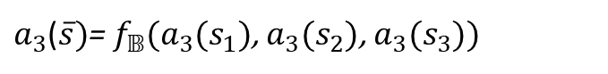
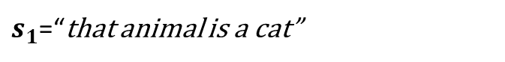
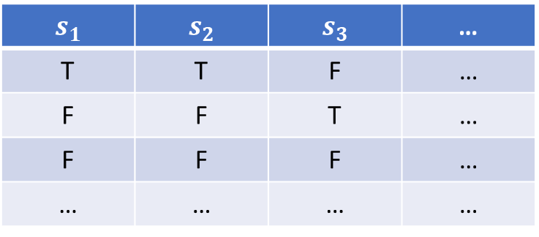
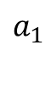
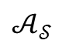
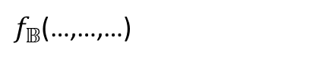
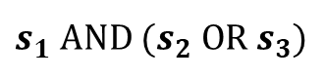
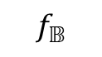
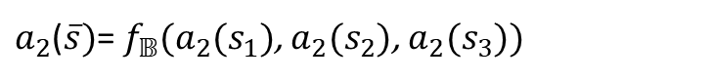

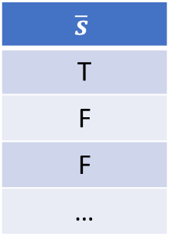
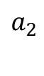
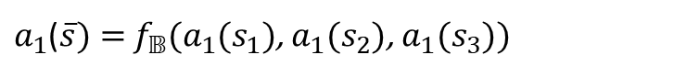
$$S$$
$$s_{1}$$ | $$s_{2}$$ | $$s_{3}$$ | …
T | T | F | …
F | F | T | …
F | F | F | …
… | … | … | …
$$\overline{s}$$
T
F
F
…
$$a_{1}$$
$a_{1}$($\overline{s})=$ $f_{𝔹}(a_{1}(s_{1})$, $a_{1}(s_{2}$), $a_{1}(s_{3}$))
$$a_{2}$$
$$f_{𝔹}$$
$a_{2}$($\overline{s})$= $f_{𝔹}(a_{2}(s_{1})$, $a_{2}(s_{2}$), $a_{2}(s_{3}$))
$$𝒜_{𝒮}$$
$$a_{3}$$
$s_{1}$ AND ${(s}_{2} OR{ s}_{3})$
$a_{3}$($\overline{s})$= $f_{𝔹}(a_{3}(s_{1})$, $a_{3}(s_{2}$), $a_{3}(s_{3}$))
$$…$$
$f_{𝔹}$(…,…,…)
$s_{1}$=“that animal is a cat”
$s_{2}$=“that animal is a mammal”
$s_{3}$=“that animal is a bird”

Slide 8
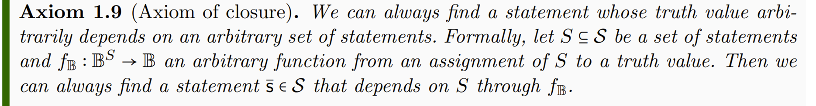

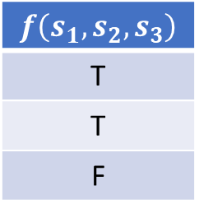
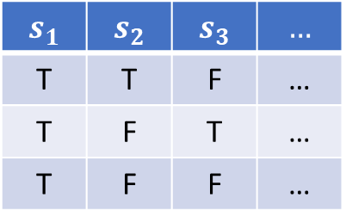
$$s_{1}$$ | $$s_{2}$$ | $$s_{3}$$ | $$…$$
T | T | F | …
T | F | T | …
T | F | F | …
$$f\left(s_{1},s_{2},s_{3}\right)$$
T
T
F
$$f_{𝔹}$$

Slide 9
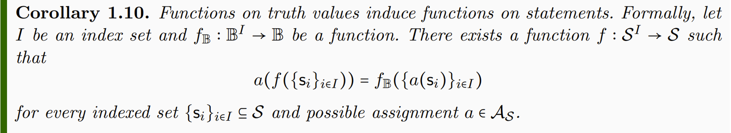

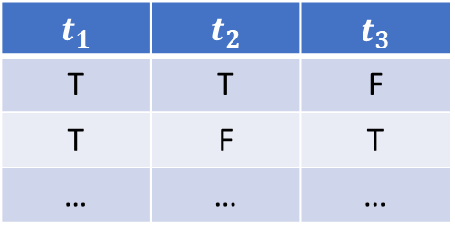
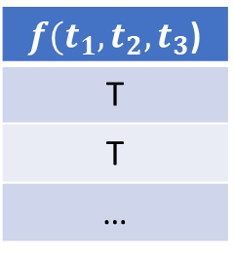
$$t_{1}$$ | $$t_{2}$$ | $$t_{3}$$
T | T | F
T | F | T
… | … | …
$f(t_{1},t_{2},t_{3}$)
T
T
…

Slide 10
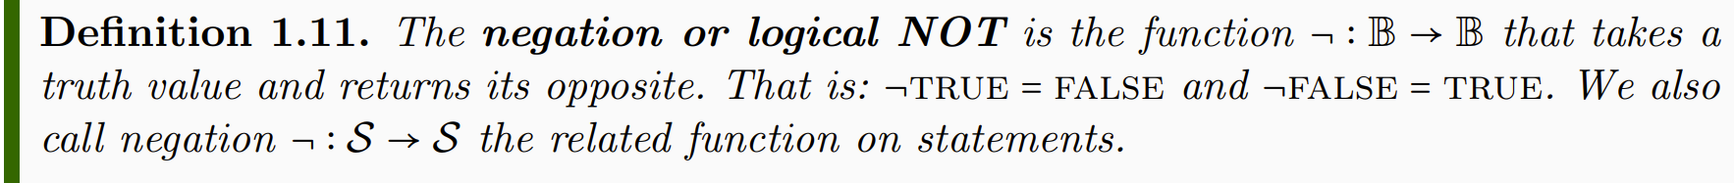
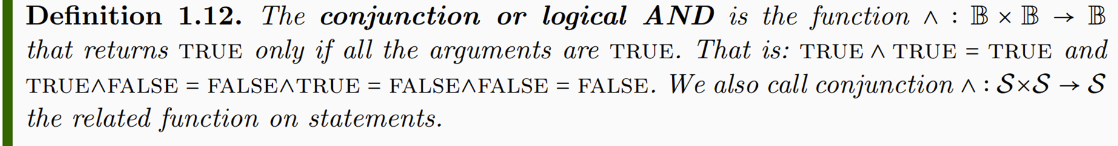
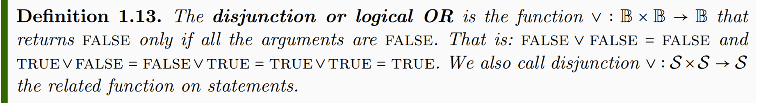

Slide 11
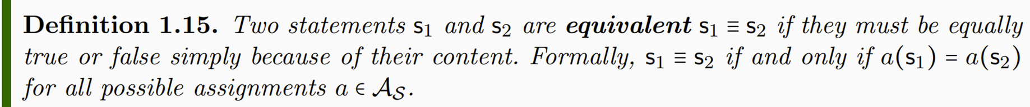

Slide 12
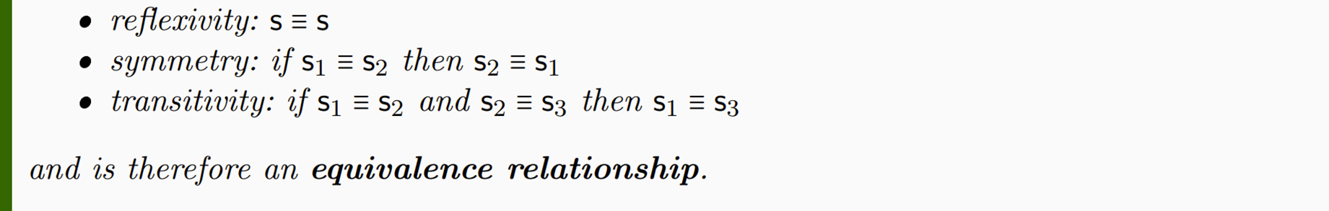
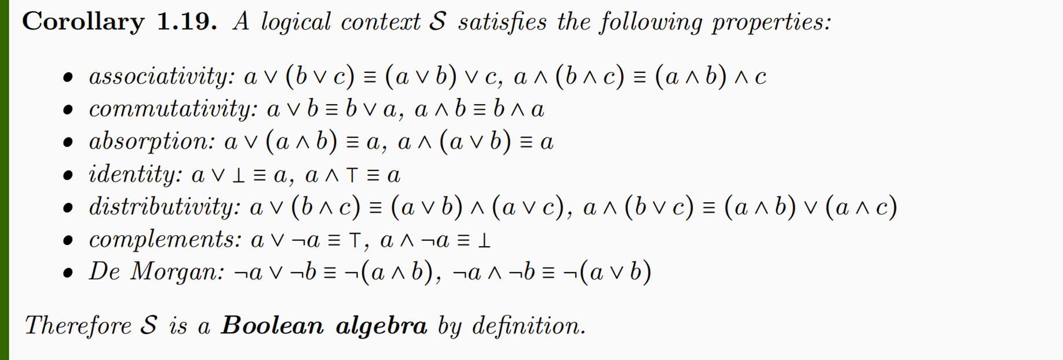

Slide 13
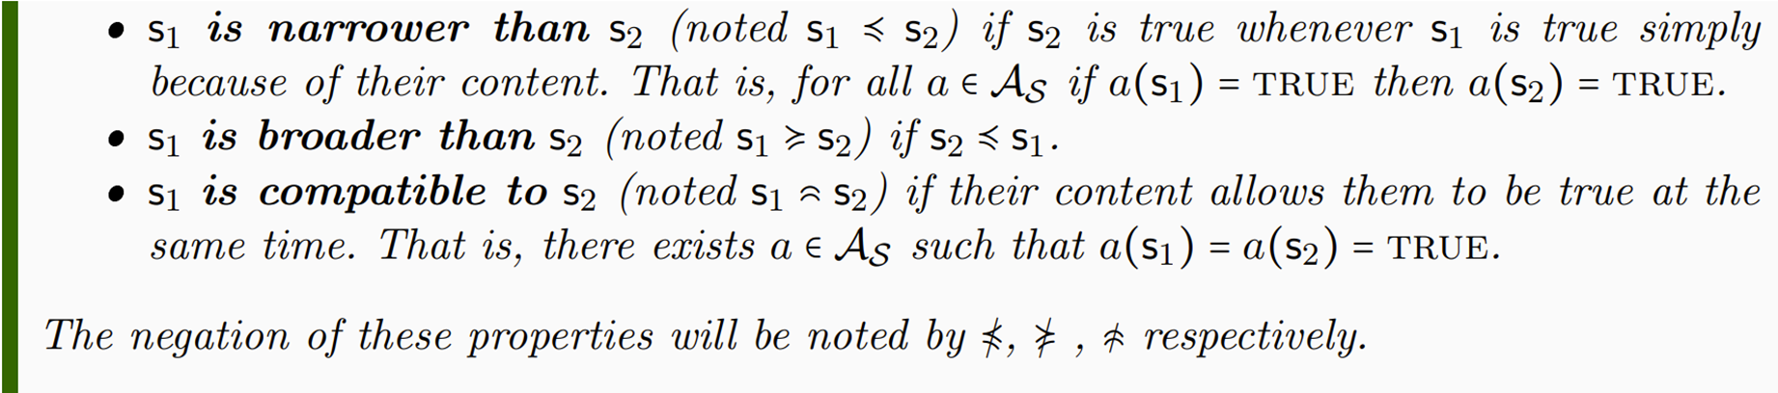
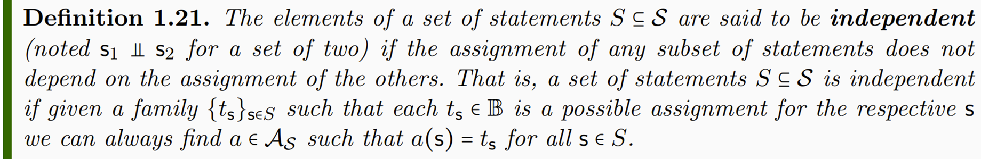

Slide 14
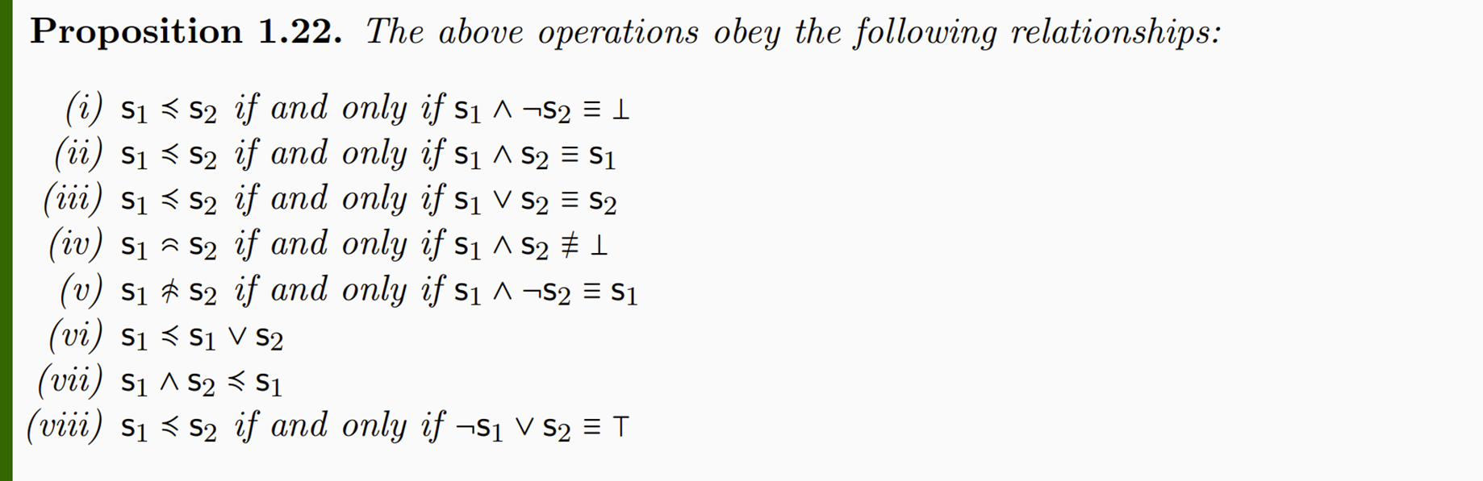

Slide 15
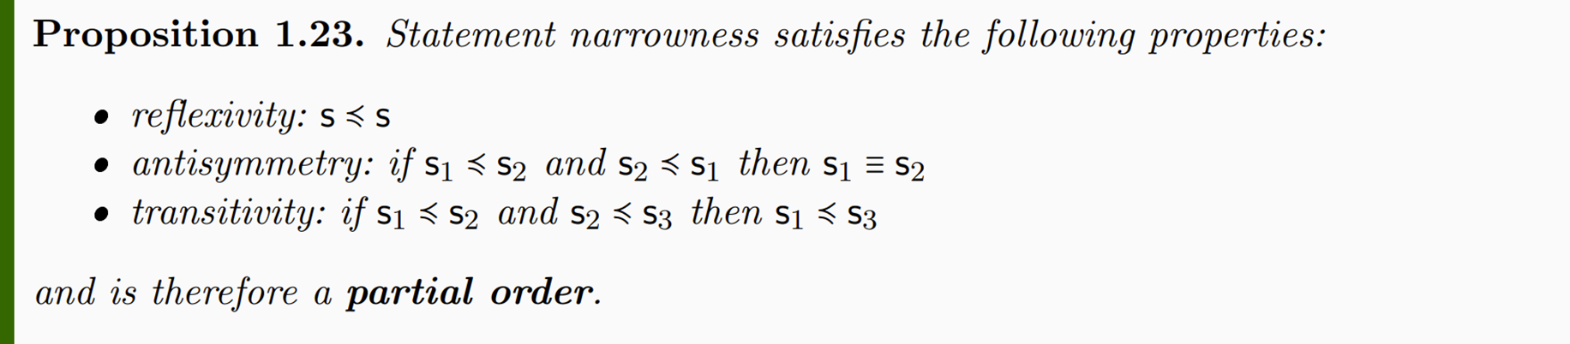
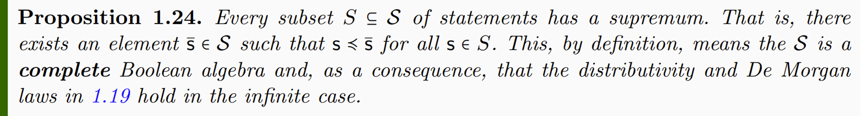
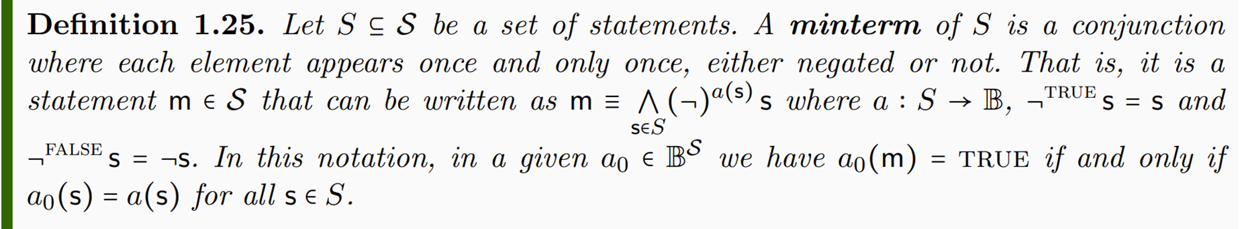

Slide 16
